Slide 1



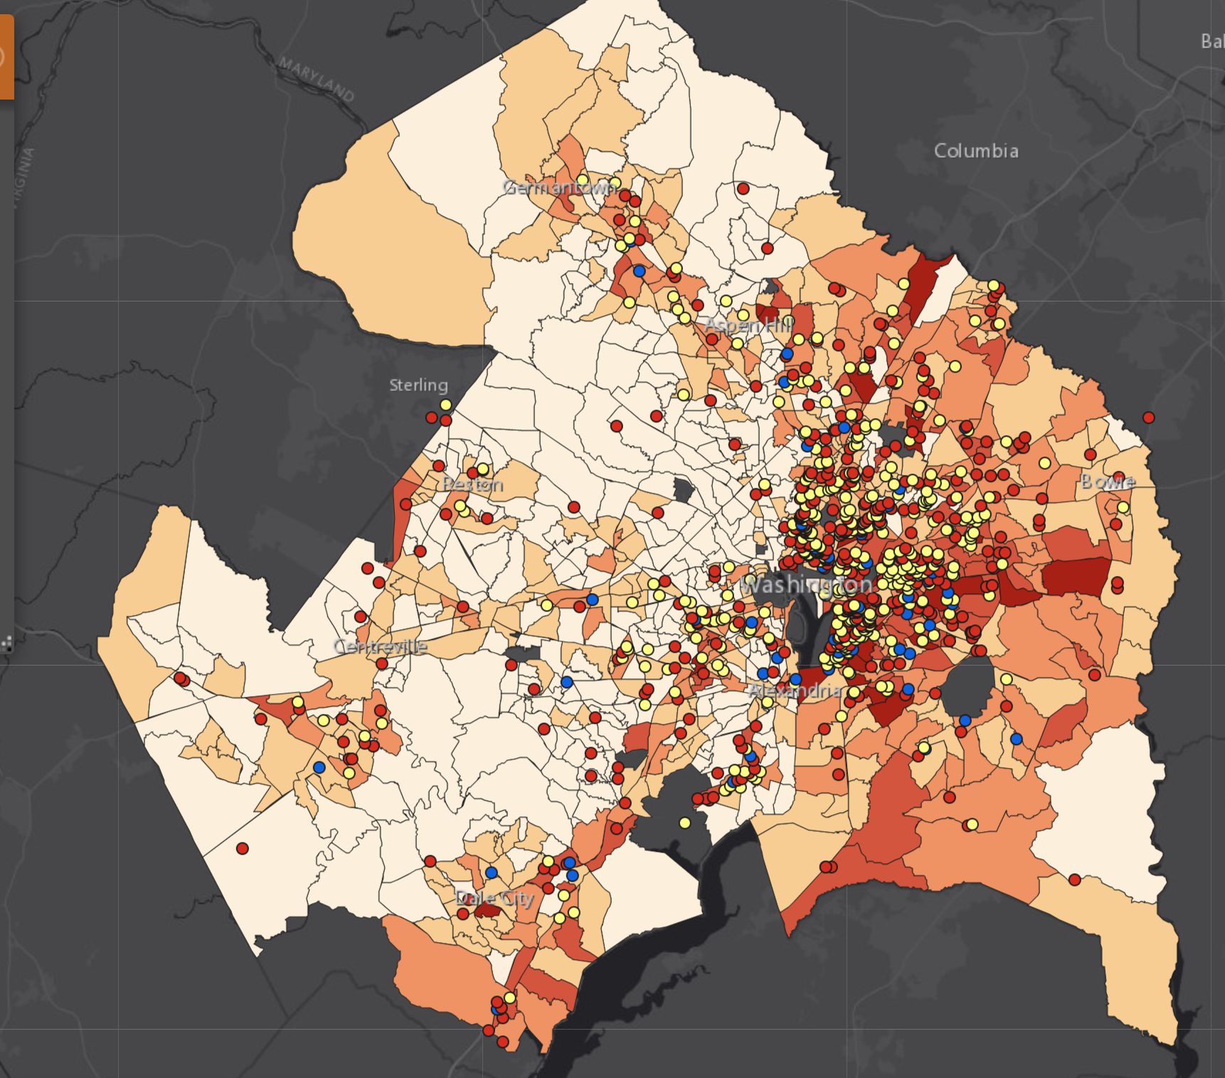
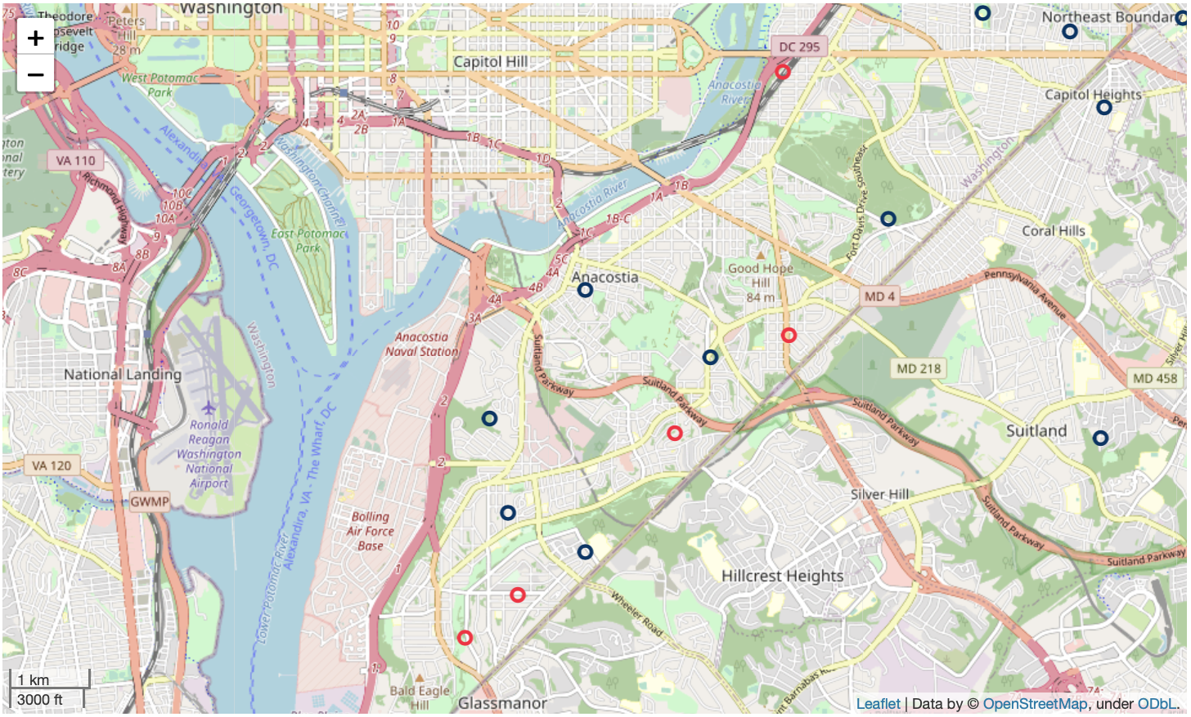

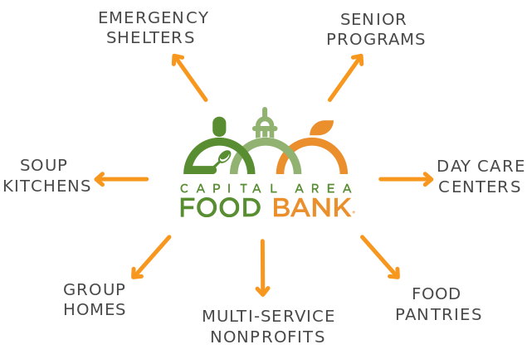

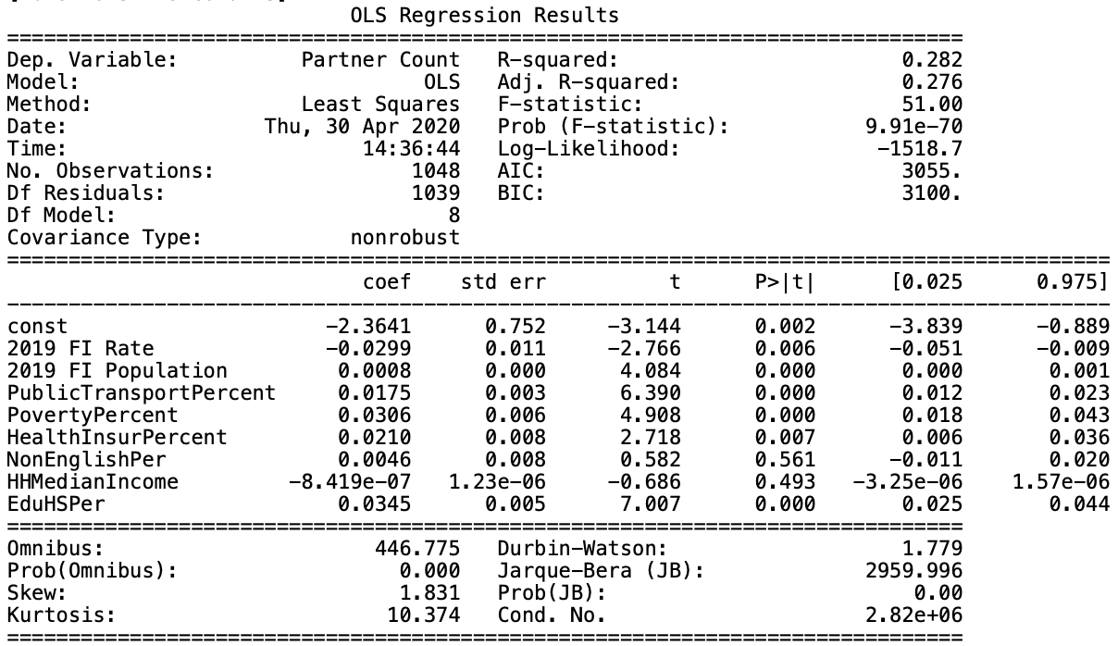









Optimizing Food Bank Resources in the DMV
Capital Area Food Bank
Client
Data
Results
Serves 380,000 individuals across the DMV
Largest Food Bank in the mid-atlantic region
Sources and distributes over 30 million meals annually
DMV Hunger Heat Map
Census Tract 98.01
FI Rate: 39.1%
FI Population: 1081
Public Transport: 44.6%
Partner Count: 0
Headquarters: Washington, DC
Point of Contact: Jake Erlich
Opportunity
Identify areas of most opportunity in the DMV area.
Recommend census tracts in greatest need of CAFB resources.
5
50
census tracts with significant negative residual values indicate areas where CAFB resources are needed
census tracts with significant positive residual values indicate areas where CAFB resources can be reallocated
Processing
Next Steps
Tools
OLS Regression Model
Python
Statsmodels
Pandas
NumPy
Folium
Target: Partner Count
Significant Predictors:
Food Insecure Rate
Food Insecure Population
Public Transport Percent
Poverty Percent
Health Insurance Percent
High School Education Percent
Identify partnerships with healthcare facilities
Find opportunities for CAFB expansion in Federal Opportunity Zones
Analyze the relationship between housing prices and density shifts in food insecure populations
Retrieve recent and time-sensitive data
DataDigestion
Special Thanks
Sapna
Bagalkotkar
Aaron Kurtz
Ben
Lin
Natalie Wolfe
Jake Erlich, Project Champion
Tim Le, Data Specialist at CAFB
Joshua Kohn, Faculty Advisor
Dr. Joseph Bailey, Course Instructor
Notes:
Results:
Looking at the results from the OLS regression, we noticed several of the predictors that were used were significant at the 5% level, such as the Food insecure Rate and Population, as well as poverty percentage, health insured percentage, high school education.
And looking at the residuals, we were able to identify 5 census tracts that had the most significant negative residual, meaning there was an extremely low number of partners, given the statistics of the area. Simply put, areas of most opportunity.
We also noticed 50 census tracts with significant positive residual values. Areas that have an abnormally high number of CAFB resources where we believe those resources may be better reallocted.

Slide 2
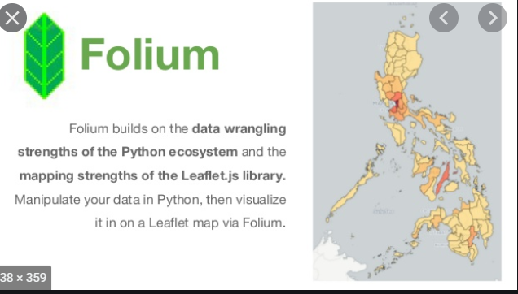
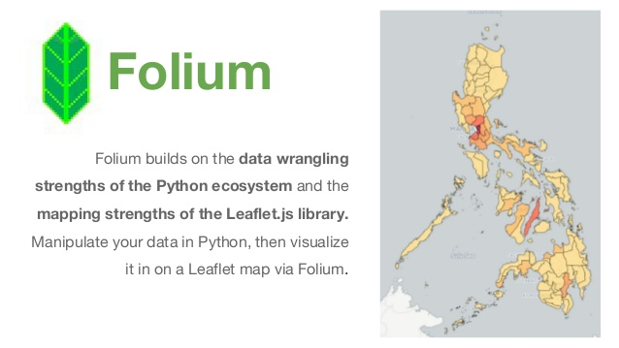



Colors:
Light Green Background: f3fbd5 Dark Orange: f3941a Dark Green: 5D9731 Middle Green: 96B977 Navy Blue: 13365c
#FCF0DC
450+ Food
Assistance Partners
Data
Client
Data
Objectives
Methodology (HHM)
Recommendations
Next Steps

Slide 3
